Slide 1
Microprocessor Architecture
Microprocessor 8085 Architecture & Pin Configuration

Slide 2
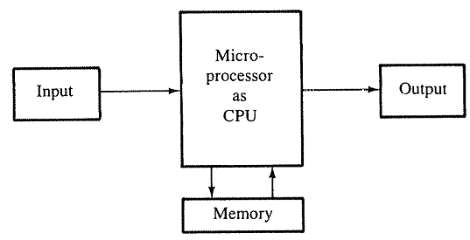
Microprocessor Architecture
A microcomputer system consists of four components, the microprocessor, memory and Input and Output devices.
The microprocessor manipulates data, controls the timing of various operations, and communicates with peripherals , memory and I/O.
Fig: A microcomputer system

Slide 3
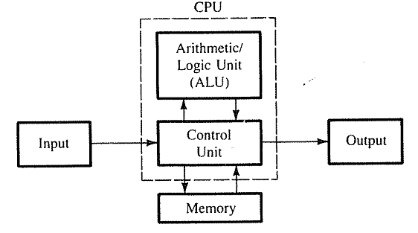
Microprocessor Architecture
The internal logic design of the microprocessor called its architecture, determines how and when various operations are performed by the microprocessor.
Fig: A microcomputer system

Slide 4
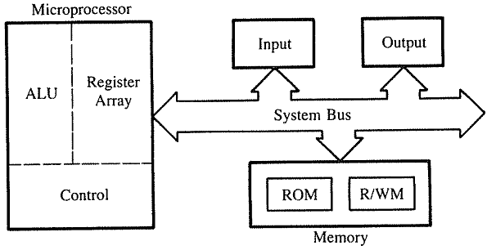
Microprocessor Architecture
The microprocessor can be divided into three segments, ALU, Register Array and Control Unit
Fig: A microcomputer system

Slide 5
Microprocessor Architecture
ALU performs arithmetical and logical operations on the data received from the memory or an input device.
Register array consists of registers identified by letters like B, C, D, E, H, L and accumulator.
These registers are primarily used to store data temporarily during the execution of a program.
Some of the registers are accessible to the user through instructions.
The control unit controls the flow of data and instructions within the computer.
The control unit provides the necessary timing and control signals to all the operations in the microcomputer.

Slide 6
Microprocessor Architecture
ALU performs arithmetical and logical operations on the data received from the memory or an input device.
Register array consists of registers identified by letters like B, C, D, E, H, L and accumulator.
These registers are primarily used to store data temporarily during the execution of a program.
Some of the registers are accessible to the user through instructions.
The control unit controls the flow of data and instructions within the computer.
The control unit provides the necessary timing and control signals to all the operations in the microcomputer.

Slide 7
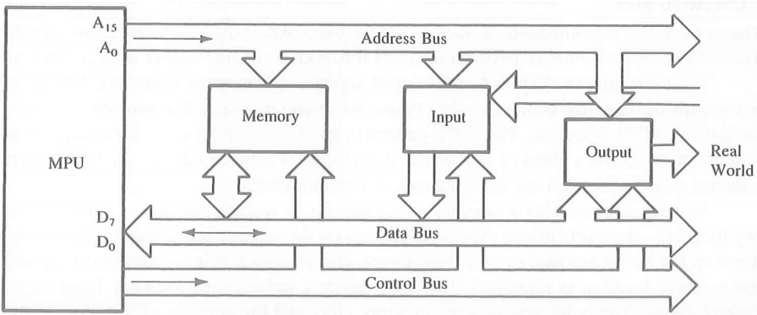
Microprocessor Architecture
The bus carries bits (data) between the microprocessor and the memory and peripheral devices.
Fig: Bus structure

Slide 8
Microprocessor Architecture
The address bus is unidirectional- bits flow in one directions- from microprocessor to peripheral devices.
Fig: Bus structure

Slide 9
Microprocessor Architecture
The data bus is bidirectional- data flow in both directions.
Fig: Bus structure

Slide 10
Microprocessor Architecture
The control bus is contained of various single lines that carry synchronization signals.
Fig: Bus structure

Slide 11
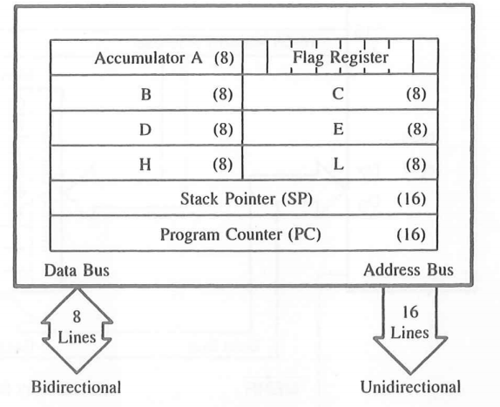
Microprocessor Architecture
The fig. shows the internal registers and the accumulator.
Fig: Registers

Slide 12
Microprocessor Architecture
Accumulator: It is an 8-bit register used to perform arithmetic, logical, I/O & LOAD/STORE operations. It is connected to internal data bus & ALU.
Fig: Registers

Slide 13
Microprocessor Architecture
General purpose register: There are 6 general purpose registers in 8085 processor, i.e. B, C, D, E, H & L. Each register can hold 8-bit data.
Fig: Registers

Slide 14
Microprocessor Architecture
General purpose register: These registers can work in pair to hold 16-bit data and their pairing combination is like B-C, D-E & H-L.
Fig: Registers

Slide 15
Microprocessor Architecture
Stack pointer: It is also a 16-bit register works like stack, which is always incremented/decremented by 2 during push & pop operations.
Fig: Registers

Slide 16
Microprocessor Architecture
Program counter: It is a 16-bit register used to store the memory address location of the next instruction to be executed.
Fig: Registers

Slide 17
Microprocessor Architecture
Flag register: It is an 8-bit register having five 1-bit flip-flops, which holds either 0 or 1 depending upon the result stored in the accumulator.
Fig: Registers

Slide 18
Microprocessor Architecture
Flag register:
These are the set of 5 flip-flops.
Sign (S)
Zero (Z)
Auxiliary Carry (AC)
Parity (P)
Carry (C)
D7 | D6 | D5 | D4 | D3 | D2 | D1 | D0
S | Z |  | AC |  | P |  | CY
Fig: Flag Register

Slide 19
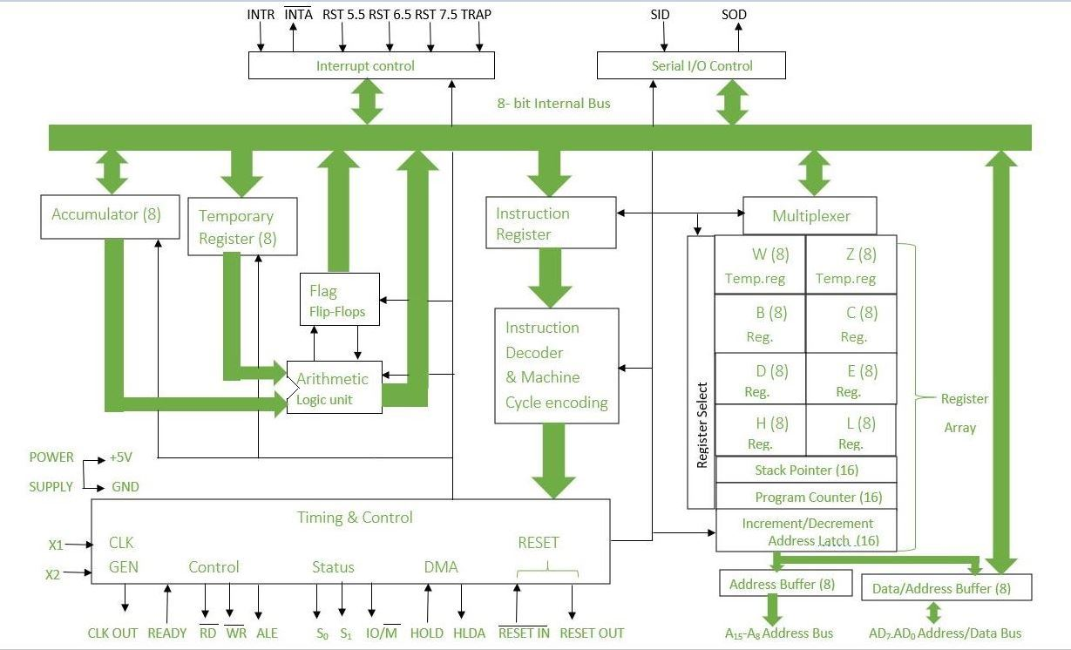
Microprocessor Architecture

Slide 20
Microprocessor Architecture
Instruction register and decoder
When an instruction is fetched from memory then it is stored in the Instruction register. Instruction decoder decodes the information present in the Instruction register.

Slide 21
Microprocessor Architecture
Timing and control unit
It provides timing and control signal to the microprocessor to perform operations. Following are the timing and control signals, which control external and internal circuits −
Control Signals: READY, RD’, WR’, ALE
Status Signals: S₀, S₁, IO/M’
DMA Signals: HOLD, HLDA
RESET Signals: RESET IN, RESET OUT

Slide 22
Microprocessor Architecture
Interrupt control
As the name suggests it controls the interrupts during a process. When a microprocessor is executing a main program and whenever an interrupt occurs, the microprocessor shifts the control from the main program to process the incoming request. After the request is completed, the control goes back to the main program.
There are 5 interrupt signals in 8085 microprocessor: INTR, (INTA)’ RST 7.5, RST 6.5, RST 5.5, TRAP.

Slide 23
Microprocessor Architecture
Serial Input/output control
It controls the serial data communication by using these two instructions: SID (Serial input data) and SOD (Serial output data).

Slide 24
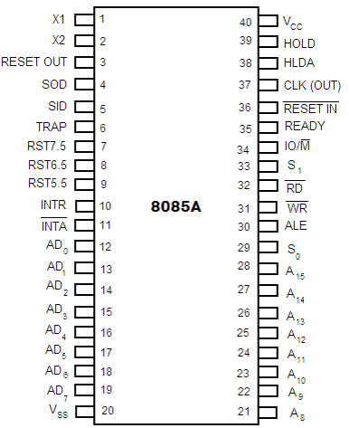
Microprocessor Architecture-Pin Configuration

Slide 25
Microprocessor Architecture-Pin Configuration
Address Bus and Data Bus
A₈ - A₁₅ (Output):
These are address bus and are used for the most significant bits of the memory address or 8-bits of I/O address. A₈ –A₁₅ are unidirectional buses.
AD₀ - AD₇ (Input/output):
These are time multiplexed address/data bus i.e. they serve dual purpose.
They are used for the least significant 8 bits of the memory address or I/O address during the first cycle.
Again they are used for data during 2nd and 3rd clock cycles.

Slide 26
Microprocessor Architecture-Pin Configuration
Control and Status Signals
ALE (Output): (Address Latch Enable). ALE goes high during first clock cycle of a machine cycle and enables the lower 8-bits of the address to be latched either into the memory or external latch.
IO/M (Output): It is a status signal which distinguishes whether the address is for memory or I/O device.
S₀, S₁ (Output): These are status signals sent by the microprocessors to distinguish the various types of operation:
S₁ | S₀ | Operations
0 | 0 | HALT
0 | 1 | WRITE
1 | 0 | READ
1 | 1 | FETCH

Slide 27
Microprocessor Architecture-Pin Configuration
Control and Status Signals
RD (Output): RD is a signal to control READ operation. When it goes low, the selected I/O device or memory is read.
WR (Output): WR is a signal to control WRITE operation. When it goes low, the data bus' data is written into the selected memory or I/O location.
READY (Input): It is used by the microprocessor to sense whether a peripheral is ready to transfer a data or not. If READY is high, the peripheral is ready. If it is low the micro processor waits till it goes high.

Slide 28
Microprocessor Architecture-Pin Configuration
Interrupts and Externally Initiated Signals
HOLD (INPUT): HOLD indicates that another device is requesting for the use of the address and data bus. The processor relinquishes the uses of the buses as soon as the current cycle is completed.
HLDA (OUTPUT): HLDA is a signal for HOLD acknowledgement which indicates that the HOLD request has been received. After the removal of this request the HLDA goes low.
INTR (Input): INTR is an Interrupt Request Signal. Among interrupts it has the lowest priority. The INTR is enabled or disabled by software.

Slide 29
Microprocessor Architecture-Pin Configuration
Interrupts and Externally Initiated Signals
INTA (Output): INTA is an interrupt acknowledgement sent by the microprocessor after INTR is received.
RST 5.5, 6.5, 7.5 and TRAP (Inputs): These all are interrupts.
The TRAP has the highest priority among interrupts. The order of priority of interrupts is as follows:
TRAP (Highest priority)
RST 7.5
RST 6.5
RST 5.5
INTR (Lowest priority).

Slide 30
Microprocessor Architecture-Pin Configuration
Reset Signals
RESET IN (Input): It resets the program counter (PC) to 0. It also resets interrupt enable and HLDA flip-flops.
RESET OUT (Output): RESET OUT indicates that the CPU is being reset. The signal can be used to reset other devices.

Slide 31
Microprocessor Architecture-Pin Configuration
Clock Signals
X₁, X₂ (Input): X₁ and X₂ are terminals to be connected to an external crystal oscillator which drives an internal circuitry of the microprocessor.
It is used to produce a suitable clock for the operation of microprocessor.
CLK (Output): CLK is a clock output for user, which can be used as the system clock for other digital ICs. Its frequency is same at which processor operates.

Slide 32
Microprocessor Architecture-Pin Configuration
Serial I/O Signals
SID (Input): SID is data line for serial input. The data on this line is loaded into the seventh bit of the accumulator when RIM instruction is executed.
SOD (Output): SOD is a data line for serial output. The seventh bit of the accumulator is output on SOD line when SIM instruction is executed.
Power Supply
V_{cc} : +5 Vlots supply
V_{ss} : ground reference

Slide 33
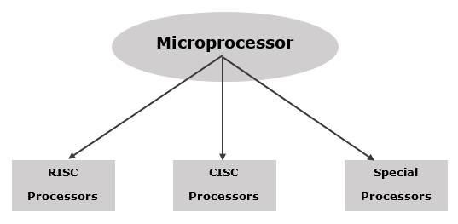
Microprocessor - Classification
A microprocessor can be classified into three categories −
RISC Processor: RISC (Reduced Instruction Set Computer), Hardwired control unit
CISC Processor: CISC (Complex Instruction Set Computer), Programmed control unit
Fig: classification of microprocessor

Slide 34
Microprocessor - Classification
Special Processors: These are the processors which are designed for some special purposes.
Input/Output Processor (DMA - direct Memory Access)
Coprocessor (math-coprocessor)
Digital Signal Processor
Fig: classification of microprocessor

